Slide 1
Divide and Conquer Algorithms
Topic 4 Discussion 1
Ryan Coon

Slide 2
Divide and Conquer Algorithms
Divide and Conquer is an algorithmic pattern. In algorithmic methods, the design is to take a dispute on a huge input, break the input into minor pieces, decide the problem on each of the small pieces, and then merge the piecewise solutions into a global solution. This mechanism of solving the problem is called the Divide & Conquer Strategy.
Divide and Conquer algorithm consists of a dispute using the following three steps.
Divide the original problem into a set of subproblems.
Conquer: Solve every subproblem individually, recursively.
Combine: Put together the solutions of the subproblems to get the solution to the whole problem.

Slide 3
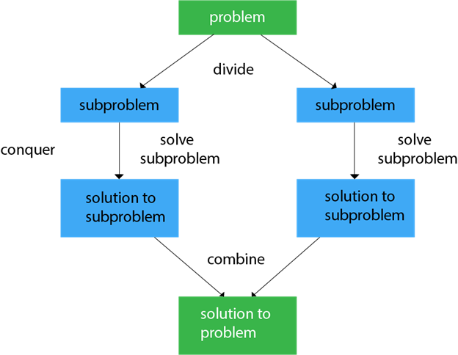
Divide and Conquer Algorithms

Slide 4
Divide and Conquer Algorithms
Applications of Divide and Conquer Approach:
Binary Search
Quicksort
Merge Sort
Closest Pair of Points
Strassen’s Algorithm
Cooley-Tukey Fast Fourier Transform algorithm
Karatsuba algorithm for fast multiplication

Slide 5
Divide and Conquer Algorithms
Advantages:
Tend to successfully solve one of the biggest problems.
It efficiently uses cache memory without occupying much space because it solves simple subproblems within the cache memory instead of accessing the slower main memory.
It is more proficient than that of its counterpart Brute Force technique.
Since these algorithms inhibit parallelism, it does not involve any modification and is handled by systems incorporating parallel processing.
Disadvantages:
Since most of its algorithms are designed by incorporating recursion, so it necessitates high memory management.
An explicit stack may overuse the space.
It may even crash the system if the recursion is performed rigorously greater than the stack present in the CPU.

Slide 6
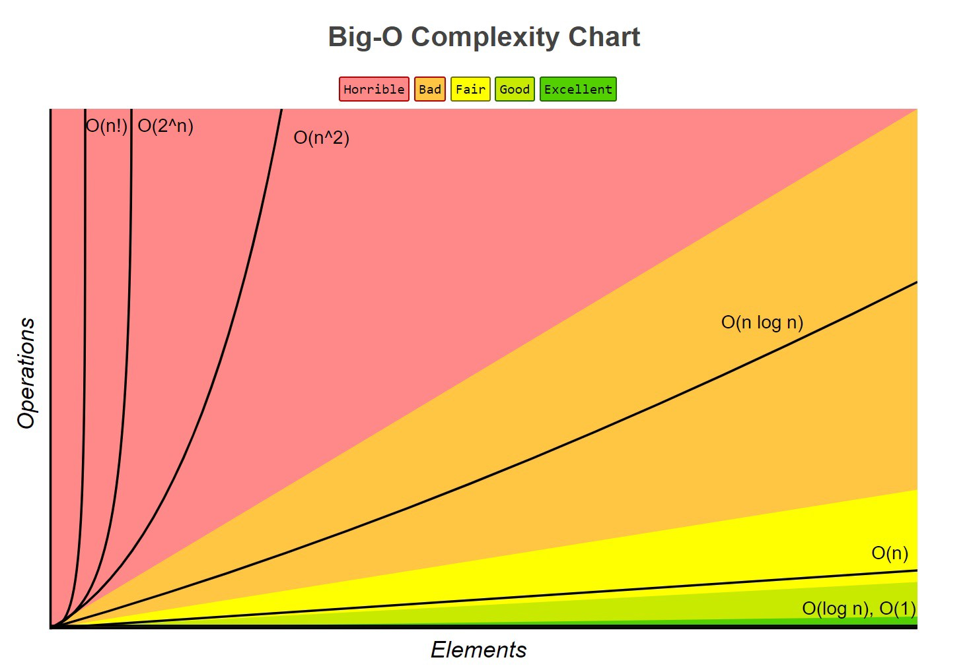
Big O Analysis
Merge Sort example
Runs in O(nlogn) time complexity.

